Slide 1
Open data with statistics.gov.scot
Liam Cavin
liam.cavin@gov.scot
1st February 2018

Slide 2
Content
Introduction to open data
Demo of statistics.gov.scot
Interactive data visualisation
Embedding evidence using linked data
Notes:
better reflect the values and aspirations of the public, expert stakeholders and Ministers
improve the alignment with the Sustainable Development Goals (SDGs), and with other Scottish Government Frameworks such as Scotland’s National Action Plan for Human Rights (SNAP) and Scotland’s Economic Strategy;
simplify the language or presentation of the NPF
ensure indicators and targets better align and support National Outcomes.
allow us to better track progress in reducing area inequality, promoting equality, and encouraging preventative approaches.

Slide 3
What is statistics.gov.scot?
A data portal, hosting (mostly) official statistics
Contains 200 datasets on a range of topics
Data comes from statistics producers such as NHS ISD, Scottish Government, and National Records of Scotland
Notes:
Open data is free, publicly available data that anyone can access and use, without restrictions. Open data can be used by businesses, nonprofits, governments and citizens to launch new initiatives and ventures, analyze trends, make data-driven decisions, and solve complex problems in all sectors of the economy.

Slide 4
What is open data?
Accessible (ideally via the internet) at no more than the cost of reproduction
Use without limitations based on users identity or intent
In a digital, machine readable format for interoperation with other data
Free of restriction on use or redistribution in its licensing conditions.
Notes:
Open data is free, publicly available data that anyone can access and use, without restrictions. Open data can be used by businesses, nonprofits, governments and citizens to launch new initiatives and ventures, analyze trends, make data-driven decisions, and solve complex problems in all sectors of the economy.

Slide 5
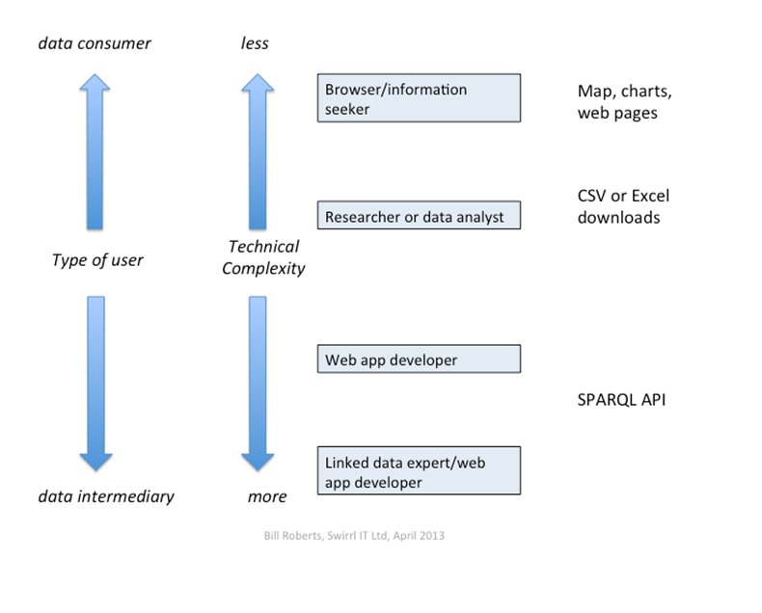
Meeting needs of different Audiences

Slide 6
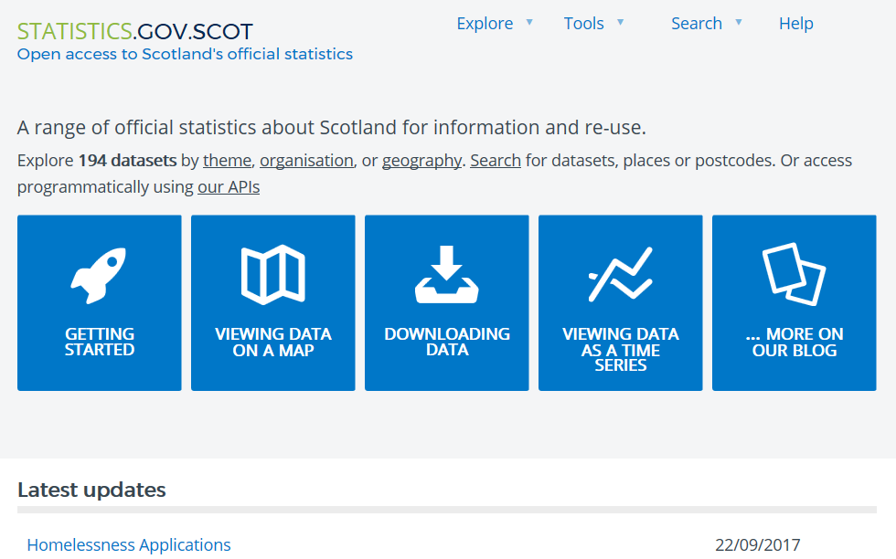
Demo of statistics.gov.scot
http://statistics.gov.scot/

Slide 7
Key website features to learn:
Browsing, finding data of interest, and generating tables
Exploratory data visualisation
Downloading data for analysis
API access

Slide 8
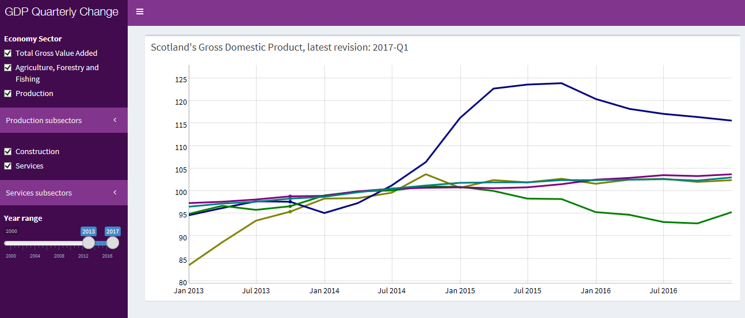
GDP R Shiny App
Gordon Bryden

Slide 9
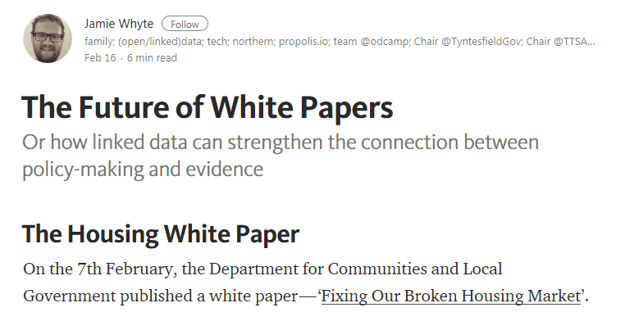
Embedding Evidence
https://medium.swirrl.com/the-future-of-white-papers-2fa6a8ab4945

Slide 10
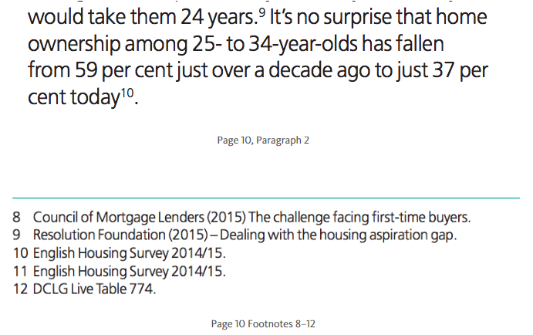
Embedding Evidence
From 'Fixing Our Broken Housing Market‘ DCLG white paper
Paper is full of data, but not accessible

Slide 11
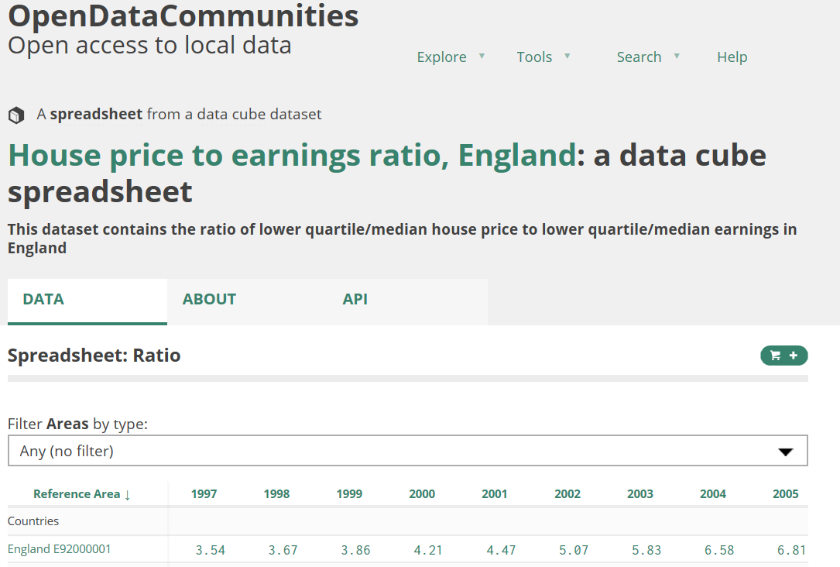
Embedding Evidence
On page 9: “Since 1998, the ratio of average house prices to average earnings has doubled”
Footnote used: “DCLG Live Table 577”
Instead, we could use a hyperlink to live data on an open data platform

Slide 12
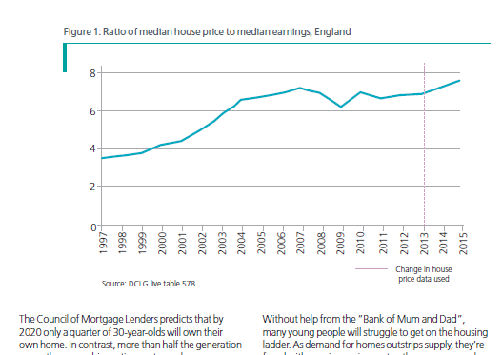
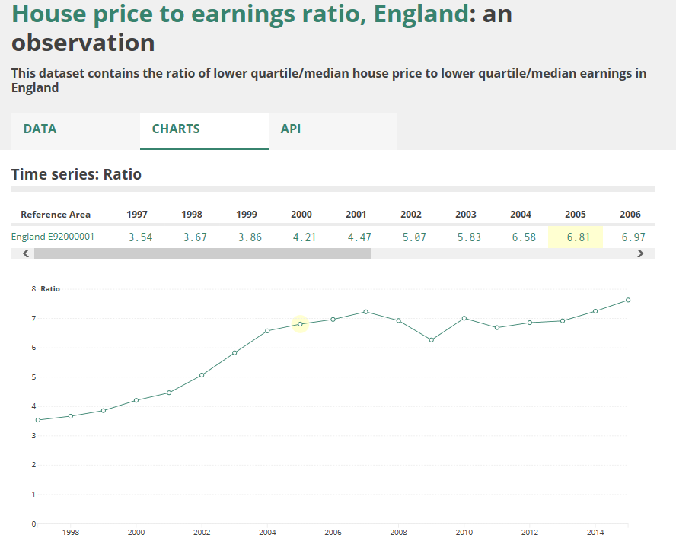
Embedding Evidence
Charts in the document could be supported with hyperlinks to charts on the open data platform

Slide 13
Any Questions?

